Slide 1
Gradient Backpropagation Tuning
Dai Bui

Slide 2
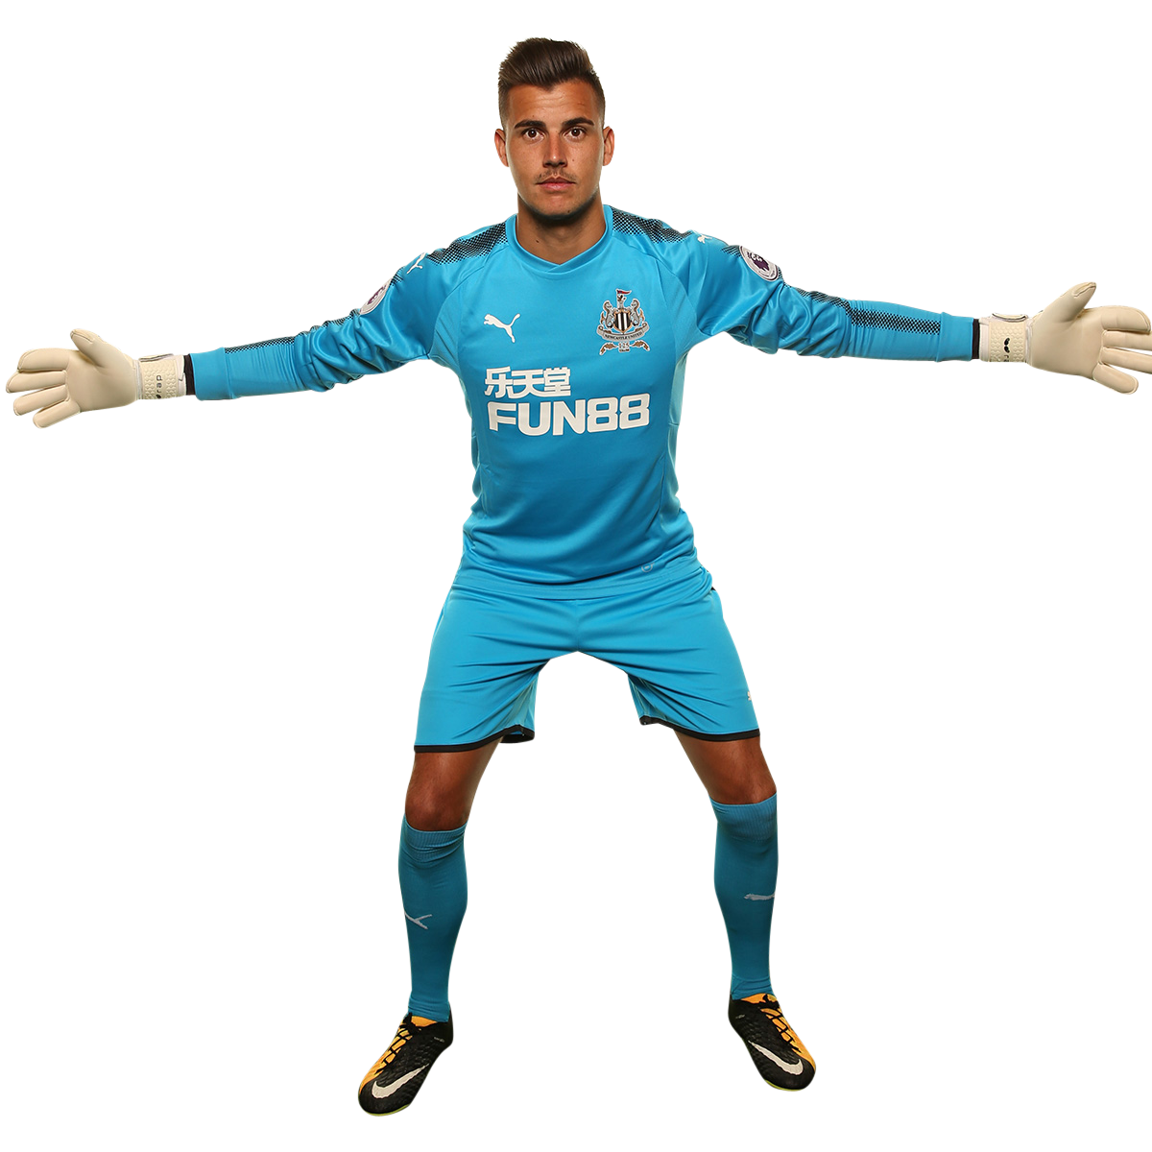
Batch Normalization
Remember that we train in batch
What happens if the mean and variance of data are shifted significantly after each batch?
Imagine training a goalkeeper
Mean of training shots are in the left, train more with left side
Mean of training shots are in the right, train more with right side
Both cases, the goalkeeper needs to switch between different skills and states, maybe he would forget his previous skills when training in the new batch
What we want to do?
Shift the training shots so that the mean is in the middle

Slide 3


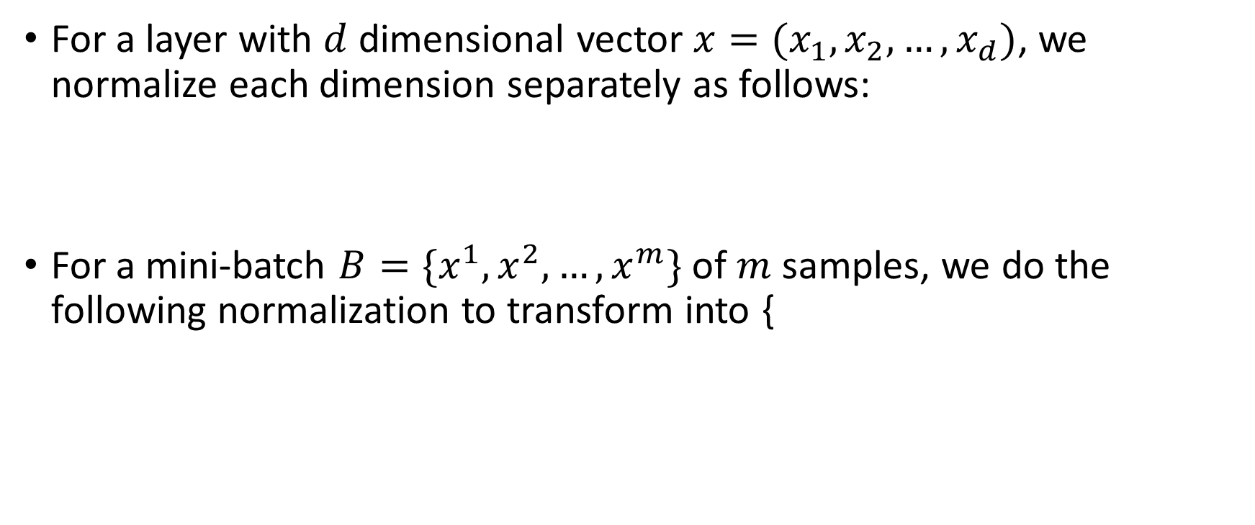

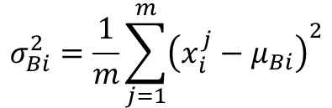

Batch Normalization
For a layer with $d$ dimensional vector $x=(x_{1},x_{2},…,x_{d})$, we normalize each dimension separately as follows:
For a mini-batch $B=\{x^{1},x^{2}, …,x^{m}\}$ of $m$ samples, we do the following normalization to transform into {
$${\hat{x}}_{k}=\frac{x_{k}−E\left[x_{k}\right]}{\sqrt{Var[x_{k}]}}$$
$$μ_{Bi}=\frac{1}{m}\sum_{j=1}^{m}{x_{i}^{j}}$$
$$σ_{Bi}^{2}=\frac{1}{m}\sum_{j=1}^{m}{{\left(x_{i}^{j}−μ_{Bi}\right)}^{2}}$$
$${\hat{x}}_{i}^{j}=\frac{x_{i}^{j}−μ_{Bi}}{\sqrt{σ_{Bi}^{2}−ε}}$$
$$y^{j}=γ{\hat{x}}_{i}^{j}+β$$

Slide 4
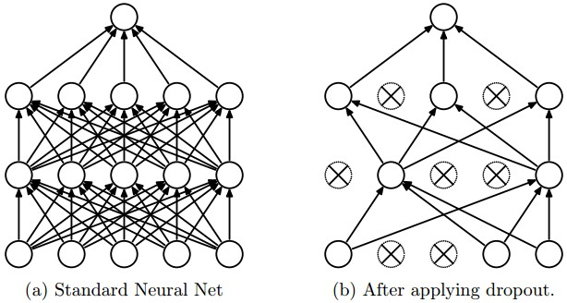
Dropout
What happens if a company depends too much on a small number of employees?
What happens if a project group depends too much on a single member?
How what happens if those employees get sick?
How do we prepare for such an event?

Slide 5
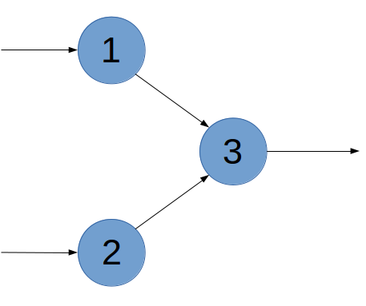
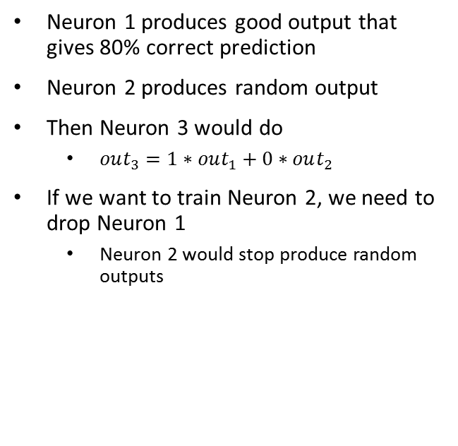
Dropout example
Neuron 1 produces good output that gives 80% correct prediction
Neuron 2 produces random output
Then Neuron 3 would do
$out_{3}=1∗out_{1}+0∗out_{2}$
If we want to train Neuron 2, we need to drop Neuron 1
Neuron 2 would stop produce random outputs

Slide 6
Practice: Batch Normalization and Dropout

